Slide 1
IT666 : Cybersecurity Practices
Chapter 9: Resilience And Physical Security

Slide 2
Demos & Hands-on
Google Data Center- 6 Layers of security
https://www.youtube.com/watch?v=kd33UVZhnAA

Slide 3
Cloud vs. Data Center
High availability (Load balancing vs. clustering)
Site considerations (Hot, Cold, Warm, Geographic dispersion)
Platform diversity
Multi-cloud systems
Continuity of operations
Capacity planning (People, Technology, Infrastructure)
Testing (Tabletop exercises, Fail over, Simulation, Parallel processing)
Backups (Onsite/offsite, Frequency, Encryption, Snapshots, Recovery, Replication, Journaling)
Power (Generators, Uninterruptible power supply (UPS))

Slide 4
Service Level Agreements (SLA)
Availability targets should be set and designed for based on organization requirements balanced against the other considerations.
Resilience, which is a component of availability that determines what type and level of potential disruptions the service or system can handle without an availability issue.
Cost, including financial, staffing, and other costs.
Responsiveness, or the ability of the system or service to respond in a timely manner as desired or required to function as designed.
Scalability either vertically (bigger) or horizontally (more) as needed to support availability, resilience, and responsiveness goals.

Slide 5
Securing a fleet of PCs
Virtualization systems and virtual desktop infrastructure (VDI) also use images to create nonpersistent systems, which are run using a “gold master” image. The gold master image is not modified when the nonpersistent system is shut down, thus ensuring that the next user has the same expected experience.
Preboot Execution Environment (PXE) allows booting over the network.

Slide 6
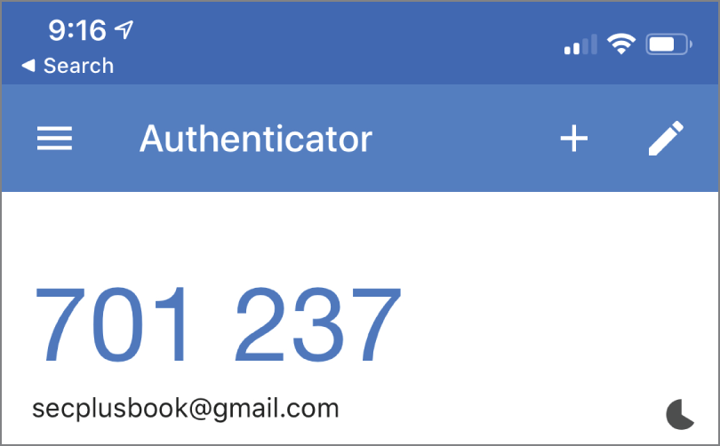
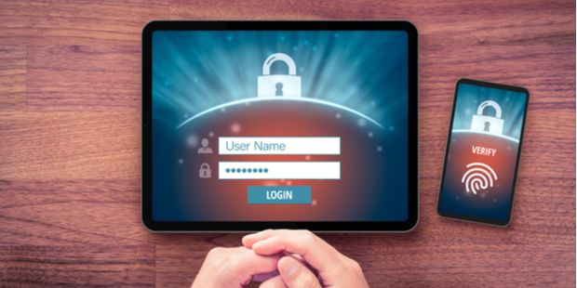
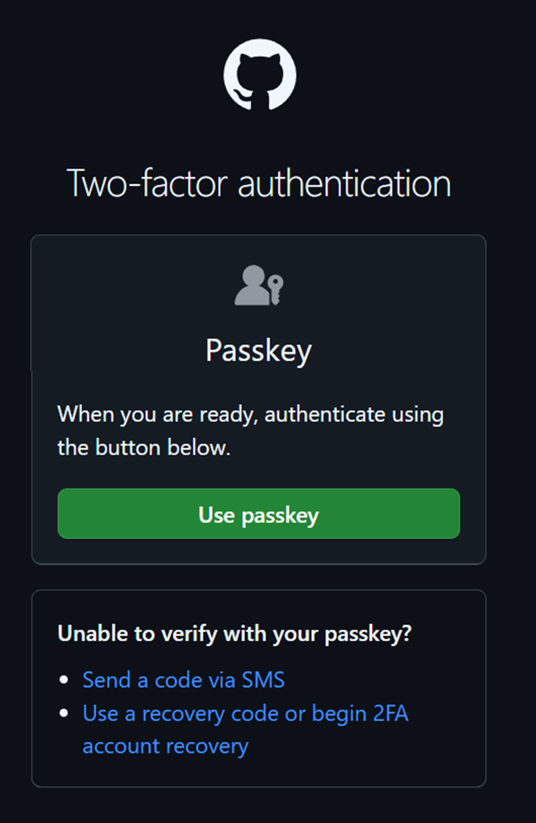

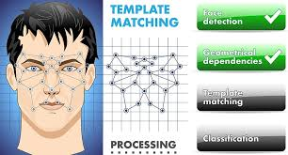
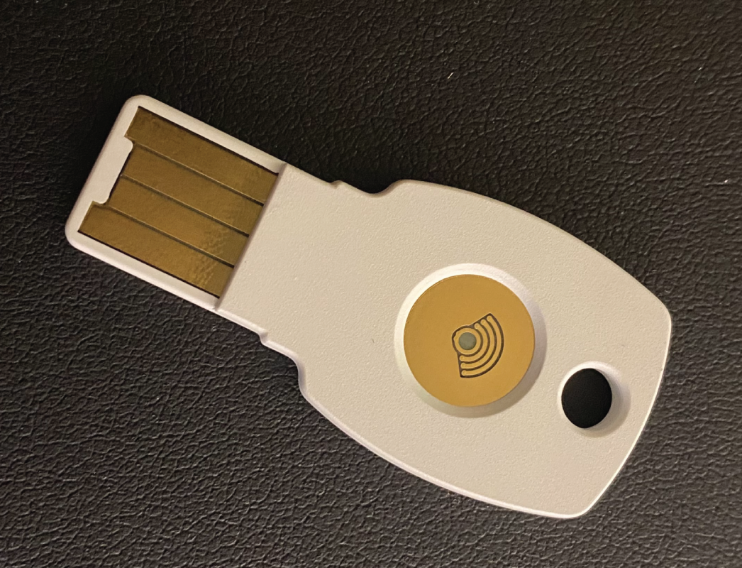
Tokens/MFA

Slide 7


Digital Wallets

Slide 8
Naomi wants to handle increasing load by scaling cloud-hosted resources as needed while having the change remain transparent to users. She also wants to allow for upgrades and system replacements transparently. What solution should she select?
Load balancing
Clustering
Geographic diversity
A hot site
Notes:
A. Naomi should select a load balancing solution. Load balancers allow multiple systems or services to appear like a single resource and can take systems out of the load-balanced pool to allow for upgrades or changes in resources required. Clustering is used to allow groups of computers to perform the same task, but without a load balancer cannot provide the same transparent service appearing as the same system. Geographic diversity and hot sites are concepts used to provide resilience but don't provide this capability.

Slide 9
What factor is a major reason organizations do not use security guards?
Reliability
Training
Cost
Social engineering
Notes:
C. Security guards can be one of the costliest physical security controls over time, making the cost of guards one of the most important deciding factors guiding when and where they will be employed. Reliability, training, and the potential for social engineering are all possible issues with security guards, but none of these is the major driver in the decision process.

Slide 10
Megan wants to deploy a sensor that is inexpensive, yet will allow her to detect humans entering and moving in a secured room. Which of the following should she select?
An infrared sensor
A microwave sensor
An ultrasonic sensor
A pressure sensor
Notes:
A. Infrared sensors balance lower cost with the ability to detect humans entering and moving in a space. Microwave sensors are more expensive but can provide better coverage, including traveling through some barriers. Ultrasonic sensors are rarely used for this purpose, and pressure sensors are limited to the pad where they are deployed, making them expensive and challenging to use for rooms or larger spaces.

Slide 11
Florian wants to test his high-availability designs but does not want to interrupt his organization's normal work. Which of the following is the least disruptive testing scenario?
A failover exercise
A tabletop exercise
A partial failover exercise
A simulation
Notes:
B. A tabletop exercise is the least disruptive form of exercise. Even simulations have some risk if an employee does not fully realize that the scenario is simulated and takes action. Failover, even partial, involves the potential for disruption.

Slide 12
LAB
Time-based One Time Password (TOTP)

